Slide 1

MMI 716 - Game Programming Patterns
Palette of Memories:
The Artist's Path to Remembrance
Project Phase II
Burcu Alakuş
2459410

Slide 2
Outline
Game Idea
Game Components
Design Patterns
Progress
Completion Evaluation

Slide 3
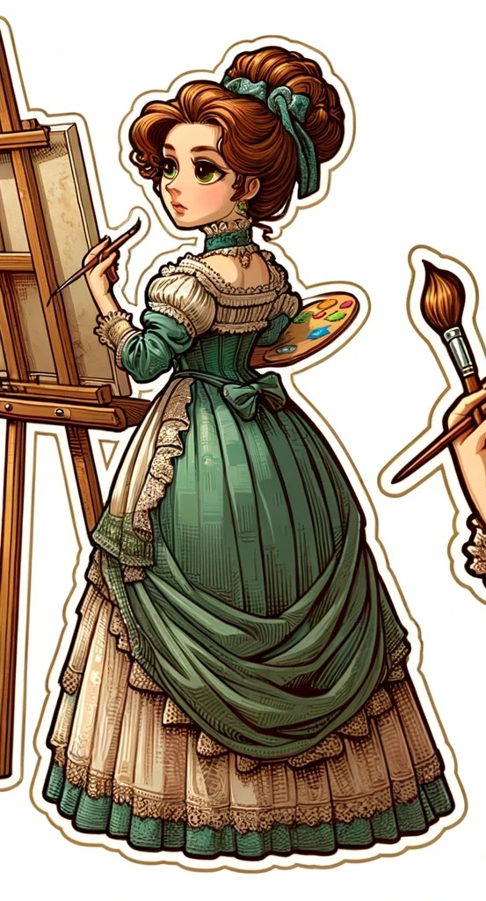
Game Idea
Palette of Memories: The Artist's Path to Remembrance
centred around a female painter who wakes up with no memory of her past
a journey through the mind and art of its protagonist
players will navigate through a series of rooms
specific items within the rooms that trigger fragments of her memories, piecing together her identity and history
offers a unique exploration of memory, identity, and creativity
Image created by DALL·E

Slide 4
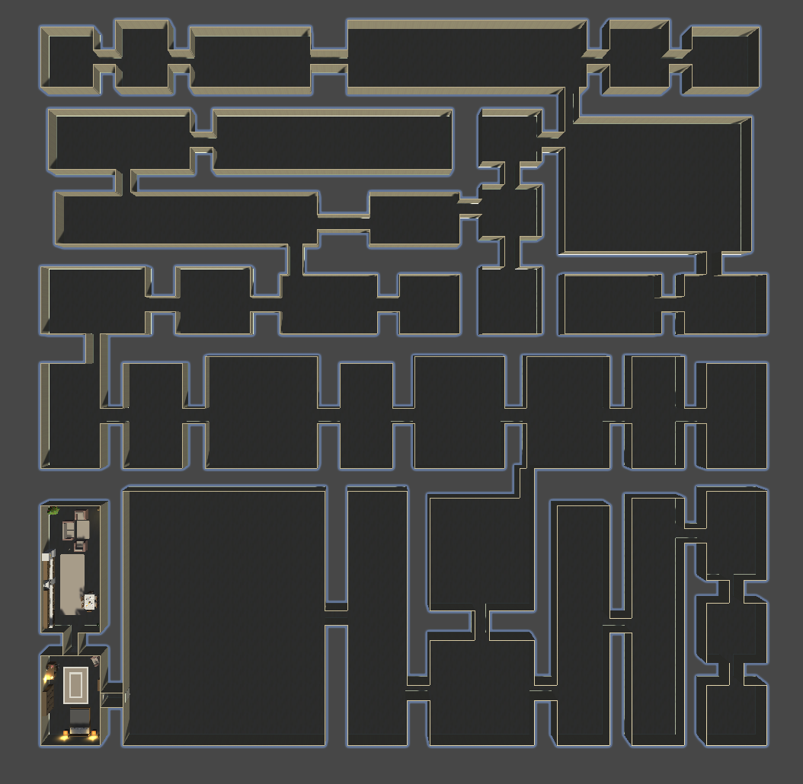
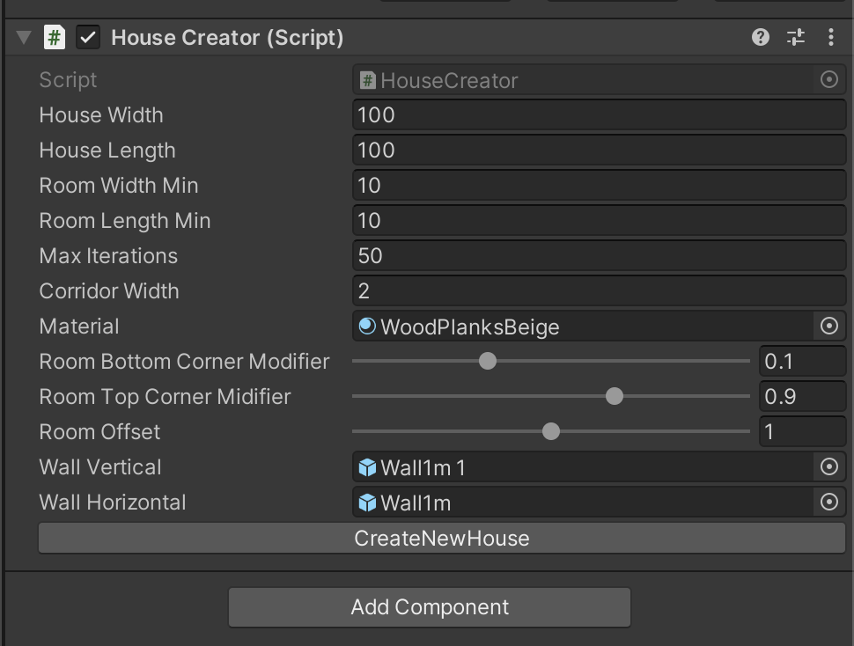
Game Components - House Creator

Slide 5
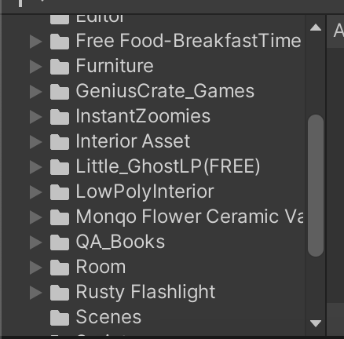
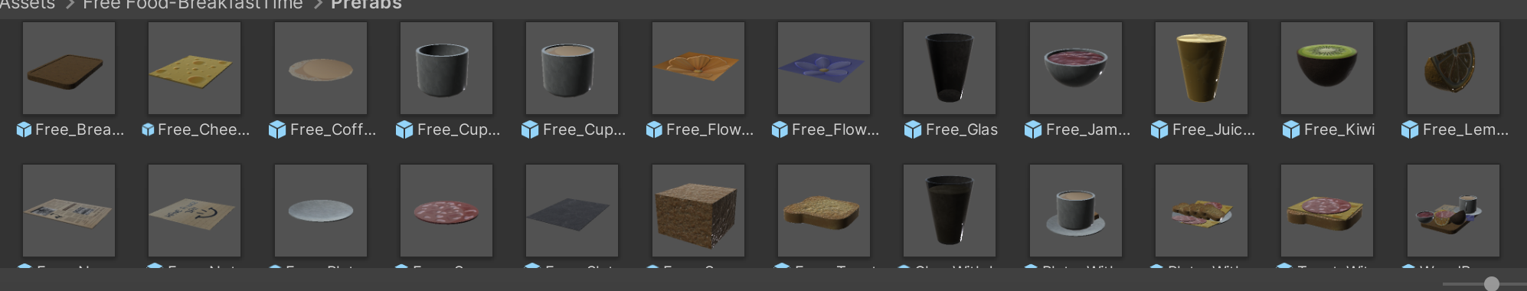
Game Components - Assets

Slide 6
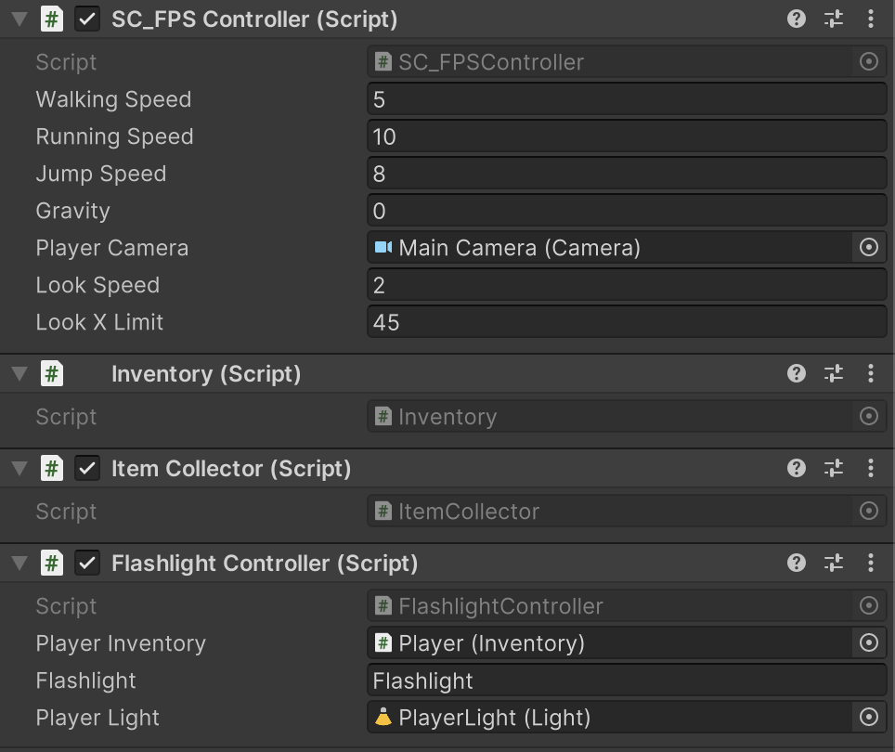
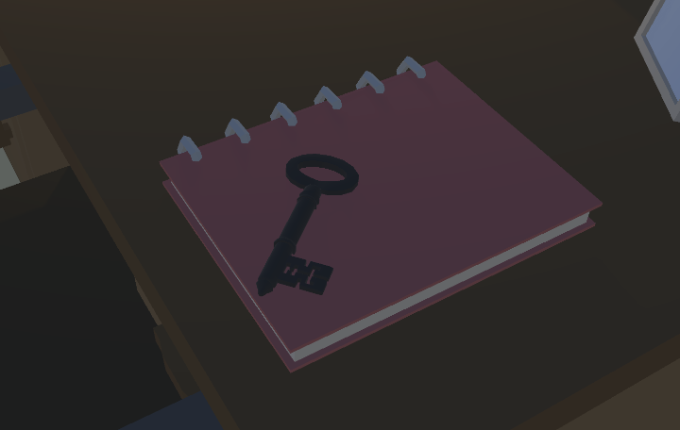

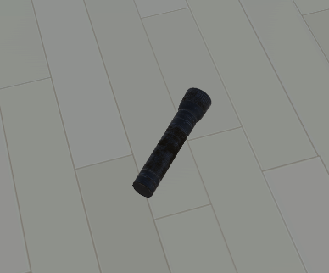
Game Components - Player
Some items with “collectable” tag

Slide 7
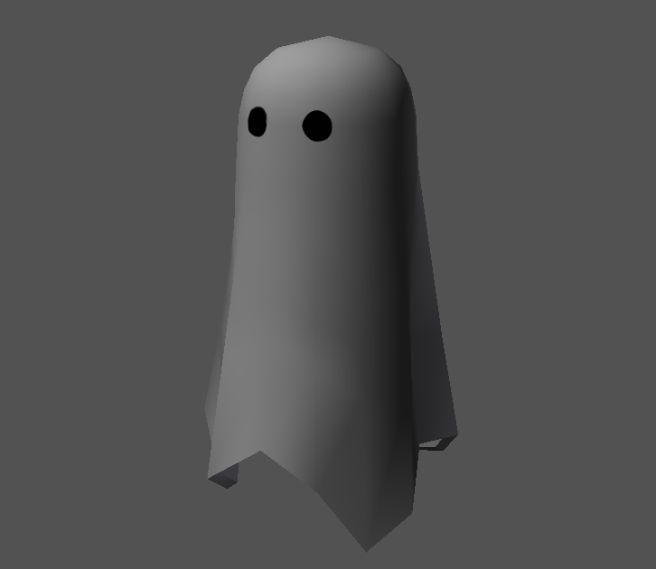
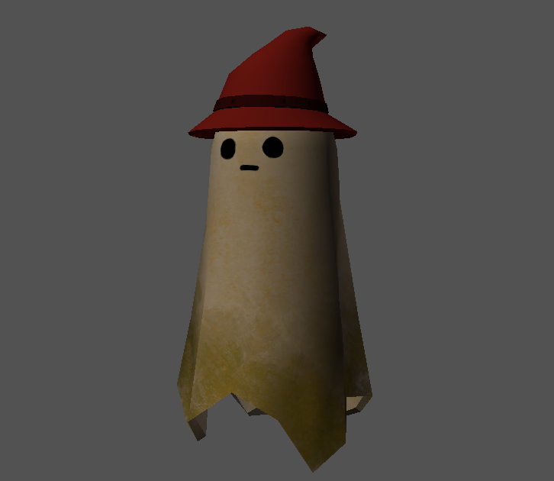
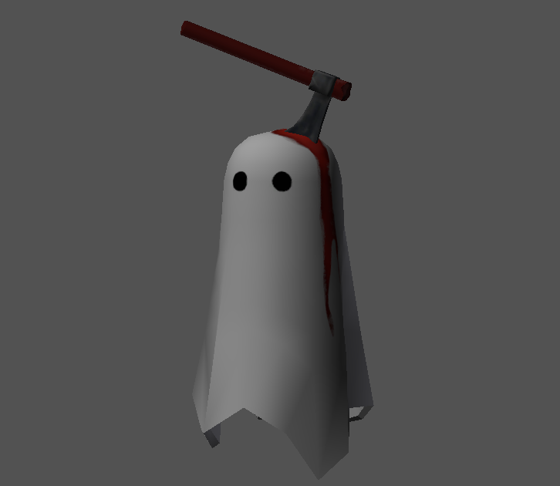
Game Components - Ghosts
Appear when specific items are collected
Chasing the player
Make creepy sounds
Disappear if the player gets far enough or after a certain period of time

Slide 8
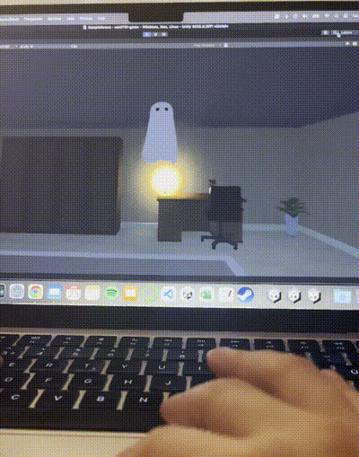
Game Components - Ghosts
Or you can mute the game ☺

Slide 9
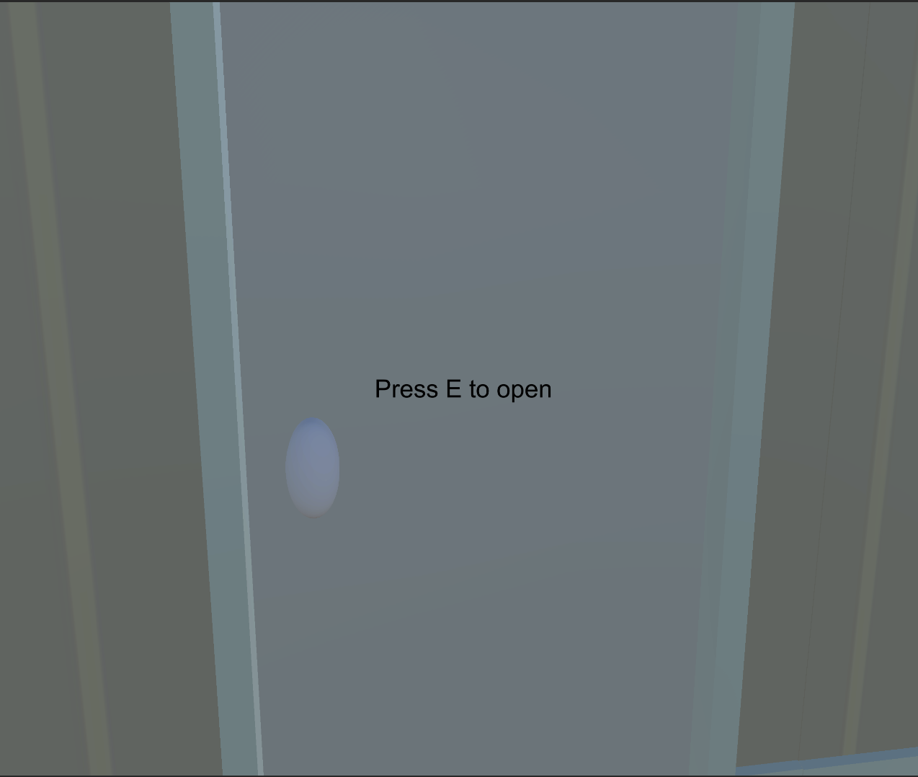
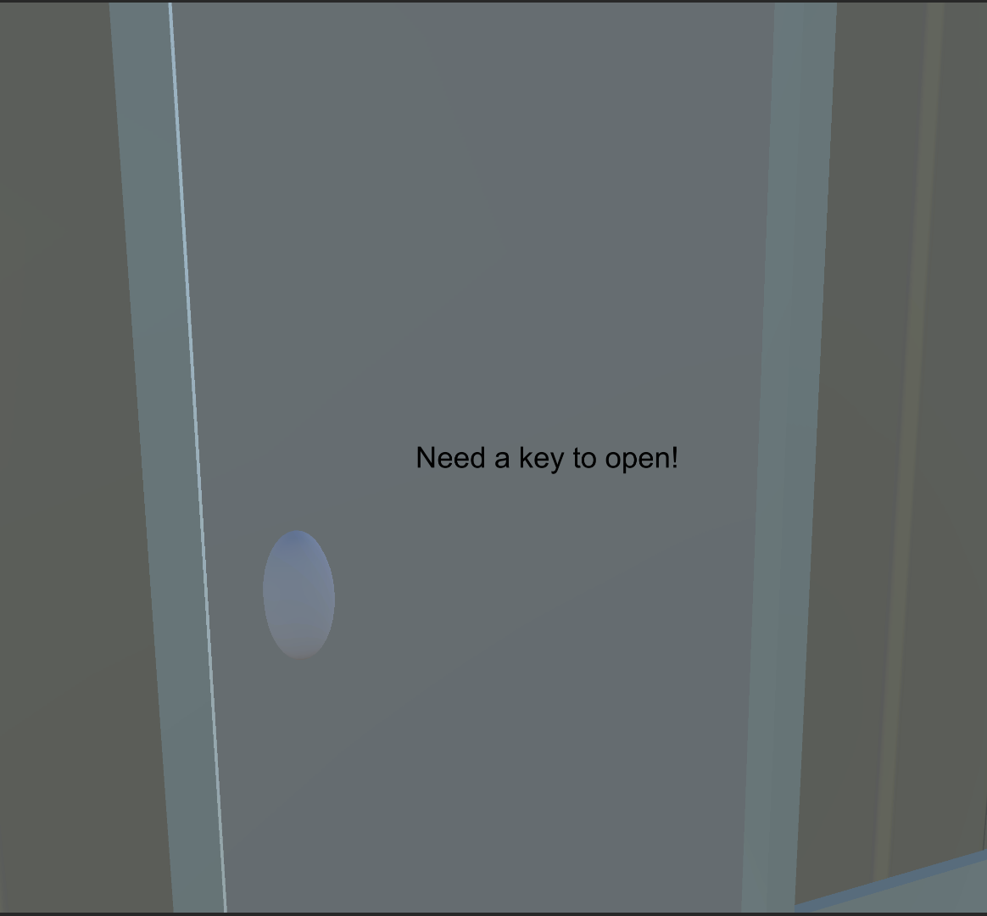
Game Components - Doors and Keys
Some rooms are locked
The player needs to find the keys

Slide 10
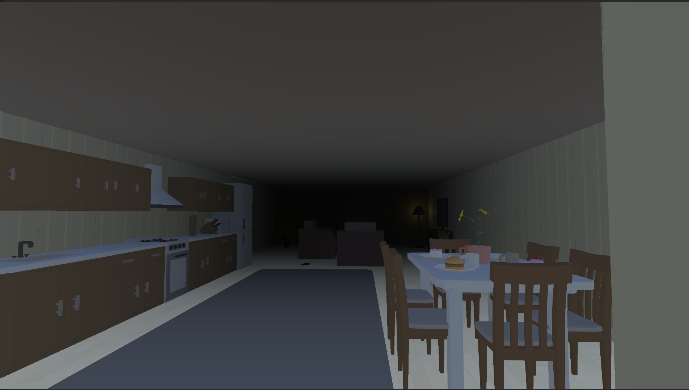
Game Components - Environment Lightning
No Skybox Material
With skybox

Slide 11
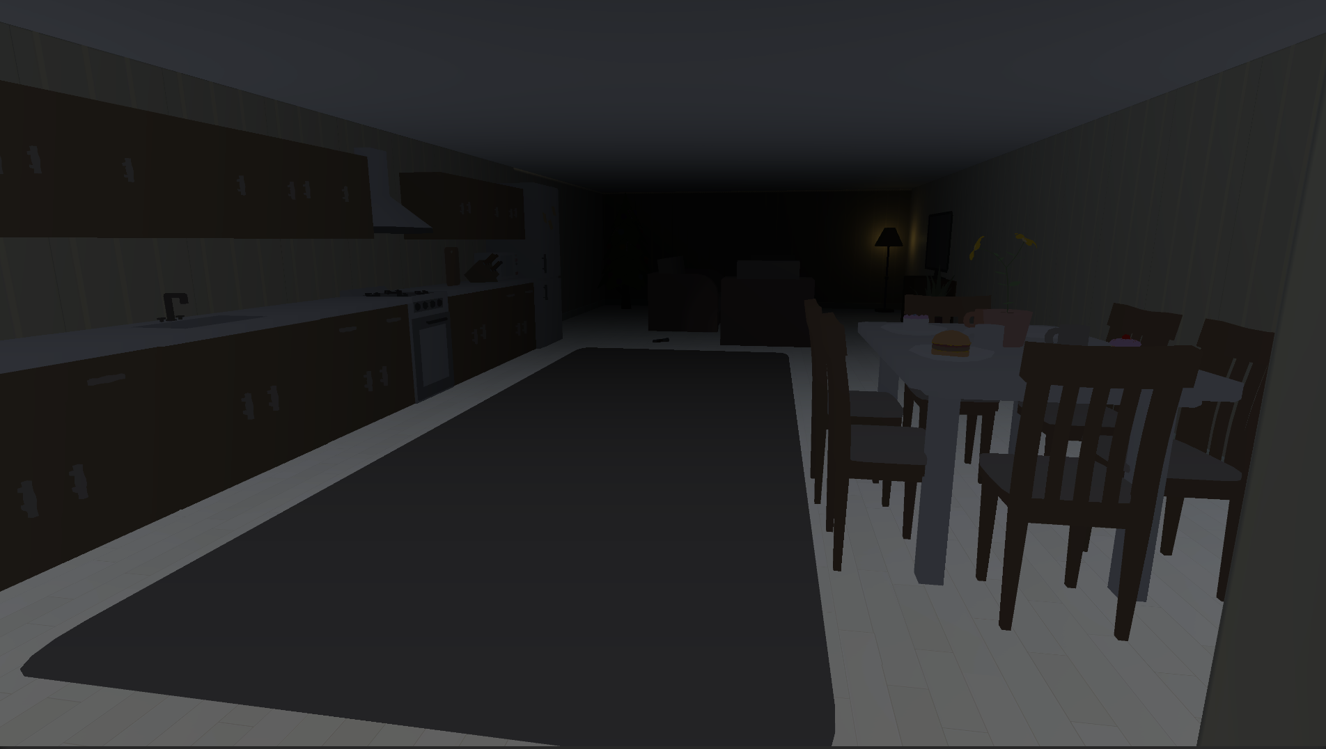
Game Components - Environment Lightning
No Skybox Material
Without skybox

Slide 12
Game Components - Fog
Foggy environment
With fog

Slide 13
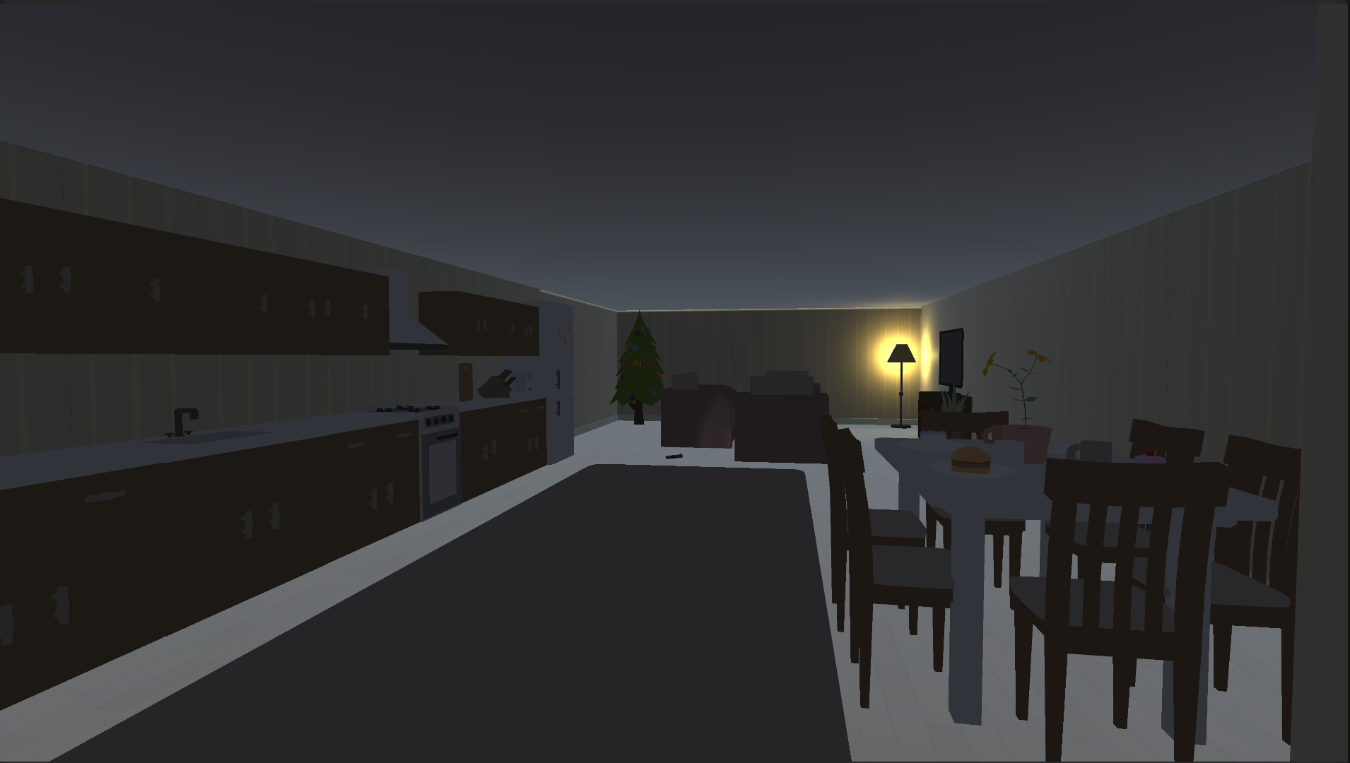
Game Components - Fog
Foggy environment
Without fog

Slide 14
Game Components - Audio
Background ambient music
Door opening sound
Ghost creepy sound
Item collecting sound
Walking & running sounds (will be added, considering floor types)

Slide 15
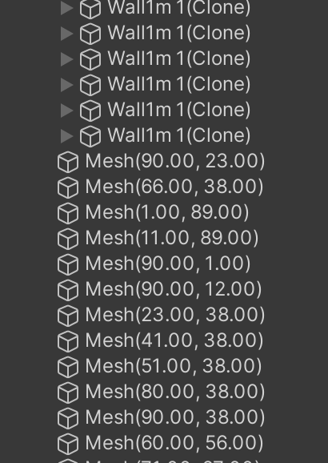
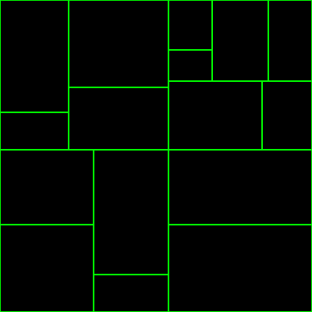
Design Patterns - Flyweight
For house creation (walls, floors, etc.) that uses binary space partitioning to generate rooms and corridors within a house area based on given dimensions and constraints and cloning one prefab, only positions differ.
Binary Space Partitioner: recursively splits a given area into rooms until they cannot be divided according to minimum size constraints.

Slide 16
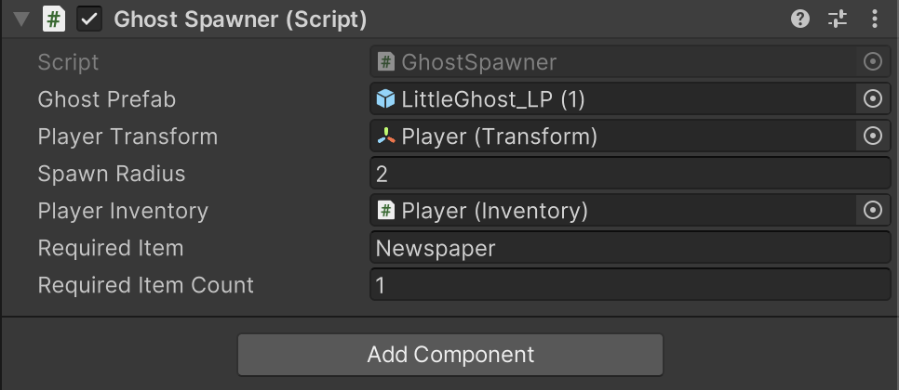
Design Patterns - Prototype
Ghost Spawner

Slide 17
Progress
Technical parts completed (at least as far as I know!)
(with menus, command pattern will be active)
The interior of the rooms will be arranged and assets will be added.
Working on the story and items to collect, will be added to the rooms when finished.
Some instructions will be added (beginning or throughout)
All will be combined.

Slide 18
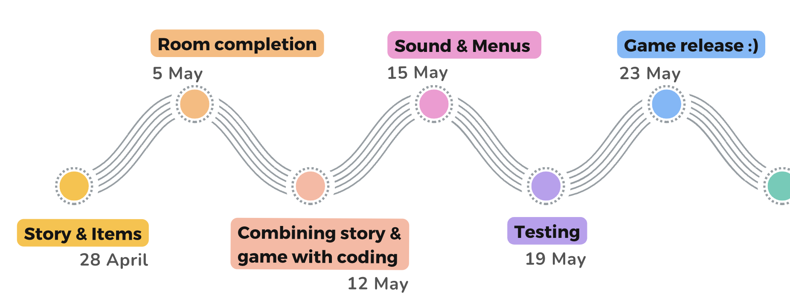
Completion Evaluation

Slide 19
Thank you for listening!

